Slide 2
Machine Learning
Rituparna Mukherjee
Yanxi Pan
Emanuel Strauss

Slide 3
Agenda
Intro to Machine Learning
Classification
Gradient Descent
Regression
Neural Networks
Other ML

Slide 4
What is Machine Learning ?
“Machine learning, a branch of artificial intelligence, concerns the construction and study of systems that can learn from data”
- Wikipedia
“Field of study that gives computers the ability to learn without being explicitly programmed”
- Arthur Samuel
“A computer program is said to learn from experience E with respect to some class of tasks T and performance measure P, if its performance at tasks in T, as measured by P, improves with experience E”
- Tom Mitchell

Slide 5
Comprises Of
Data
Comprises of massive number of data points which we wish to analyze
Feature
An individual measurable property (attribute ) of a datapoint being observed
ML Algorithm
A procedure which is designed to continuously learn from data and evolve
Model
A model artifact that is created by training on the data using a ML Algorithm

Slide 6
Why Machine Learning
For operating at scale
To enable automation
To find hidden patterns in massive data sets
Performs better than humans by continuously learning

Slide 7
Applications of Machine Learning
Natural Language Processing
Health Care
Recommendation Systems
Detecting Faulty Airline Equipments
Fraud Protection
Computer Vision

Slide 8
Natural Language Process (NLP)
NLP is a field of computer science, artificial intelligence, and computational linguistics concerned with the interactions between computers and human (natural) languages.
Machine Learning in context of NLP is a set of statistical techniques for identifying aspects of text (sentiment, parts of speech etc.)
NLP applications
Sentiment Analysis
Recommendation Systems (videos, search results etc.)
Language Understanding (Siri, OK google, Amazon ECHO)

Slide 9
Health Care
Machine Learning is widely used in the area of health care:
Medical imaging: Developing image diagnostic tools
Medical Diagnosis: For example whether a tumor is malignant or not
Drug Discovery: Researchers are using ML, especially deep learning for early stages of drug design

Slide 10
Recommendation System
A lot of products that we as users consume uses Machine learning especially when it comes to recommendations:
Video recommendations on Youtube, Amazon etc.
Movie recommendations on Netflix, IMDB
Online shopping recommendations
Recommendations for restaurants

Slide 11
Computer Vision
Computer vision is concerned with the automatic extraction, analysis and understanding of useful information from a single image or a sequence of images.
Medical image analysis
Image Search
Traffic Enforcement Camera
3D Reconstruction from Multiple Images

Slide 12
Other Applications
Search
Marketplace Ranking
Site Integrity

Slide 13
Supervised and Unsupervised Learning
Supervised Learning
Supervised learning is the Machine Learning task of inferring a function from labeled training data.
A supervised learning algorithm analyses labeled training data and produces a model which can be then used to label new data points.
Unsupervised learning? (Won’t be covered in detail)
Unsupervised learning is a type of machine learning algorithm used to draw inferences from datasets consisting of input data without labeled responses.
The most common application is cluster analysis, which is used for exploratory data analysis to find hidden patterns or grouping in data.

Slide 14
Classification
In machine learning and statistics, classification is the problem of identifying to which of a set of categories (classes) a new observation belongs, on the basis of a training set of data containing observations (or instances) whose category membership is known

Slide 15
Binary and Multiclass Classification
In machine learning, binary or boolean classification is the problem of classifying instances into one of two classes (positive and negative)
Multiclass or multinomial classification is the problem of classifying instances into one of the more than two classes

Slide 16
Example: predict rain
Binary classification problem
Based on what we know from previous weather forecasts, predict if it will be raining at some future time
Abundant historical data:
Rain next hour | Cur Temp | Cur Humid | Day of year | Time of day | Cloudy? | Rain 50 miles west
T | 65 | 98 | 91 | 8 | T | F
F | 91 | 56 | 137 | 14 | F | F
T | 78 | 83 | 208 | 11 | F | T
T | 88 | 90 | 173 | 15 | T | T
F | 11 | 24 | 51 | 23 | F | F
F | 103 | 84 | 195 | 14 | F | T
F | 56 | 88 | 74 | 9 | T | F
T | 68 | 99 | 304 | 13 | T | F

Slide 17
Boolean Classification
Output Label
Input Features
Training data consists of historical labeled examples
In the rain example, each data point represents the state in some time and place
Labeled training examples come in many forms:
Make a move in a game, does it lead to a win?
Given an email, is it spam?
View a movie, and rate if it was good or bad
Common theme: lots of previous examples to learn from.
Typically input features are vectors of continuous values
Rain next hour | Cur Temp | Cur Humid | Day of year | Time of day | Cloudy? | Rain 50 miles west
T | 65 | 98 | 91 | 8 | T | F
F | 91 | 56 | 137 | 14 | F | F
T | 78 | 83 | 208 | 11 | F | T
T | 88 | 90 | 173 | 15 | T | T
F | 11 | 24 | 51 | 23 | F | F
F | 103 | 84 | 195 | 14 | F | T
F | 56 | 88 | 74 | 9 | T | F
T | 68 | 99 | 304 | 13 | T | F

Slide 18
Performance Metrics
Precision and Recall
Precision: The precision for a class is the number of true positives (i.e. the number of items correctly labeled as belonging to a class) divided by the total number of elements labeled as belonging to the same class (i.e. the sum of true positives and false positives
Recall: Defined as the number of true positives divided by the total number of elements that actually belong to a class (i.e. the sum of true positives and false negatives, which are items which were not labeled as belonging to the same class but should have been)

Slide 19
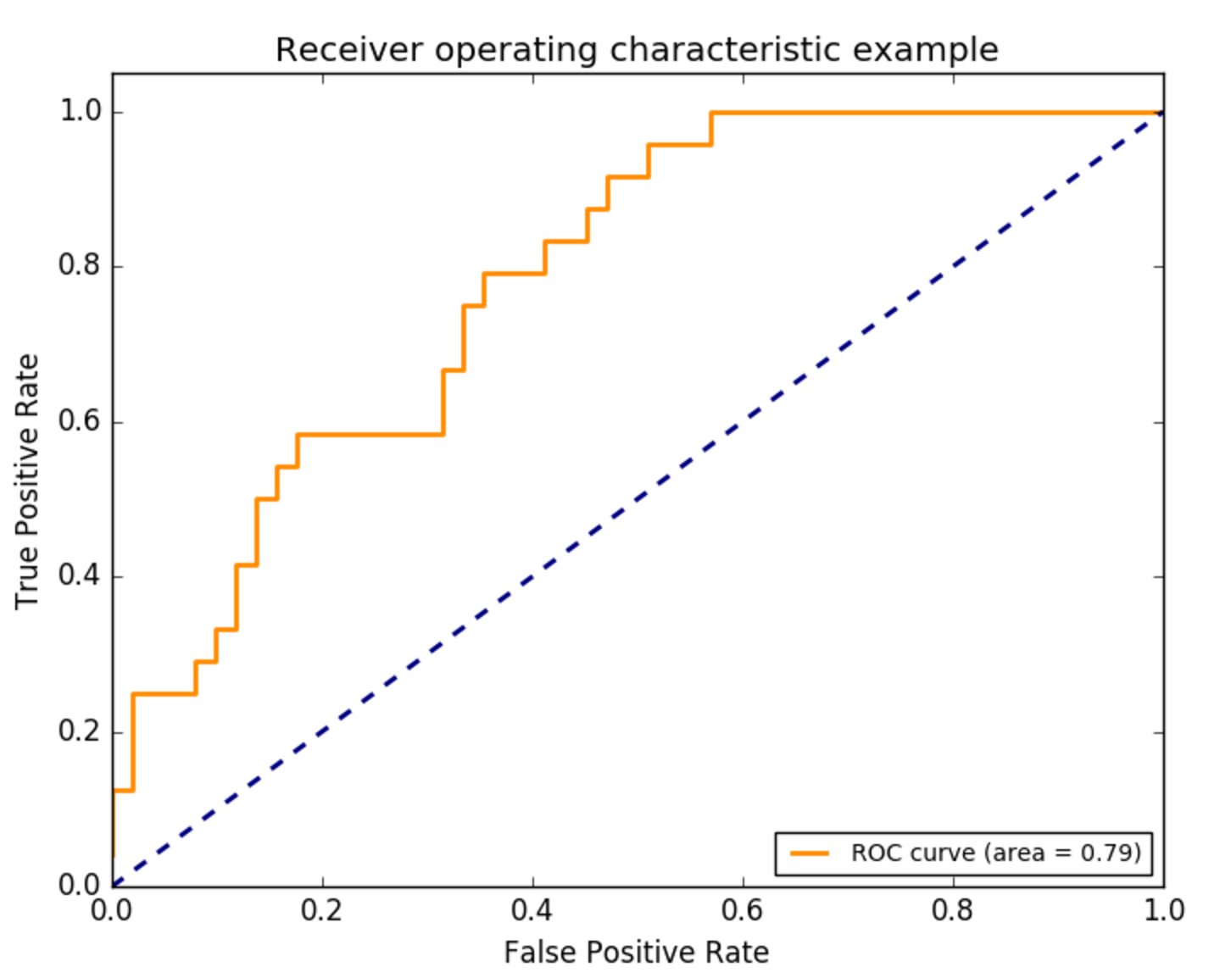
Accuracy: Is the proportion of true results (both true positives and true negatives) among the total number of cases examined.
ROC (Receiver operating characteristic curve): Graphical plot that illustrates performance of a binary classifier as its discrimination threshold is varied. The curve is created by plotting the true positive rate (TPR) against the false positive rate (FPR) at various threshold settings.

Slide 20
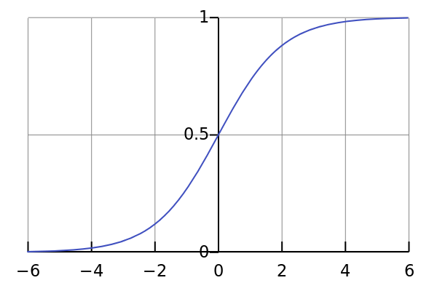
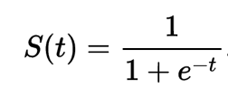
Logistic Regression
Logistic regression is a statistical method for analyzing a dataset in which there are one or more independent variables that determine an outcome. The outcome is measured with a dichotomous variable (in which there are only two possible outcomes).
A Logistic function or logistic curve is a common "S" shape (sigmoid curve) with equation:

Slide 21
The ‘t’ in the function represents θ⊤x
Where θ : Are the parameters i.e. weights associated with the features.
θ⊤ : Transpose of theta
X: Denotes the input vector of a data point
The logistic “squashes” the value of θ⊤x into the range [0,1] so that we may interpret S(t) as a probability.
If the probability >= 0.5 then the data point is attributed to the positive class
If the probability < 0.5 then the data point is attributed to the negative class.

Slide 22
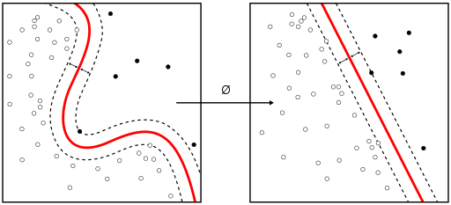
Support Vector Machines
Given a set of training examples, each labeled as belonging to one or the other of two categories, an SVM training algorithm builds a model that assigns new examples to one category or the other.
An SVM model is a representation of the examples as points in space, mapped so that the examples of the separate categories are divided by a clear gap (decision boundary) that is as wide as possible.
New examples are then mapped into that same space and predicted to belong to a category based on which side of the gap they fall

Slide 23
Random Forests
Random forests or random decision forests are an ensemble learning method for classification and other tasks, that operate by constructing a multitude of decision trees at training time and outputting the class that is the mode of the classes (classification) of the individual trees.
Decision tree is a decision support tool that uses a tree-like graph or model of decisions and their possible consequences.
Decision tree learning uses a decision tree as a predictive model which maps observations about an item (represented in the branches) to conclusions about the item's target class (represented in the leaves).

Slide 24
Example
Will it rain?
4/8
20 questions approach to machine learning
Goal is to create a tree, where each node ‘asks a question’
Answer to question at each node determines which subtree to visit
Eventually end up at a leaf with a label or probability
Cloudy?
Yes
No
1/4
3/4
Day of Year > 99
No
Yes
Rain next hour | Cur Temp | Cur Humid | Day of year | Time of day | Cloudy? | Rain 50 miles west
T | 65 | 98 | 91 | 8 | T | F
F | 91 | 56 | 137 | 14 | F | F
T | 78 | 83 | 208 | 11 | F | T
T | 88 | 90 | 173 | 15 | T | T
F | 11 | 24 | 51 | 23 | F | F
F | 103 | 84 | 195 | 14 | F | T
F | 56 | 88 | 74 | 9 | T | F
T | 68 | 99 | 304 | 13 | T | F
0/1
3/3

Slide 25
Lab - Classification

